Slide 1
Dealing with DAOs and De-Fi in International Proceedings
8 June 2025

Slide 2
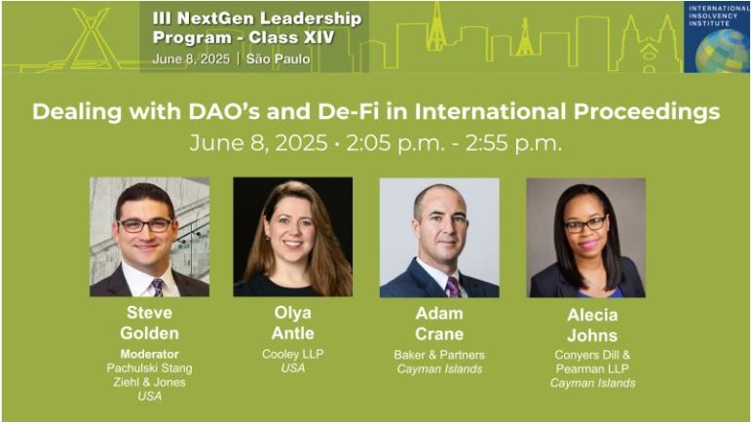

Slide 3
Why are DAOs important to Insolvency Professionals?
DAO treasuries worldwide are estimated to manage assets exceeding USD 25 billion.
See:
  World Economic Forum, Decentralized Autonomous Organization Toolkit: Insight Paper (January 2023)
  UK Law Commission, Decentralized Autonomous Organisations (DAOs): A Scoping Paper (July 2024)
  https://deepdao.io/organizations
  https://dacxi.medium.com/blockchain-crowdfunding-2025-2030-unleashing-hypergrowth-disrupting-global-fundraising-fc43d7a944a2

Slide 4
Why are DAOs important to Insolvency Professionals?
DAO treasuries have nearly doubled since 2023
At the same time, the attack surface is expanding (e.g., the ByBit heist), raising stakes and risk of failure
Yet, the legal architecture that governs bankruptcy, receivership and partnership was drafted for enterprises run by people, posing the following questions for insolvency professionals:
  How do we identify the debtor in a purely digital catastrophe?
  How do we determine the forum and jurisdiction for potential filings?
  How do we locate and marshal on-chain assets?

Slide 5
What is a DAO in the Eyes of the Law? (Competing Entity Theories)
General partnership analysis
  Samuels v. Lido DAO, No. 23-cv-06492 (N.D. Cal. Nov. 18, 2024) – motion to dismiss denied; “meaningful participation” turns token-holders into partners.
  Sarcuni v. bZx DAO, 664 F. Supp. 3d 1100, 1117-18 (S.D. Cal. 2023) – even passive token ownership can support partnership allegations.
Unincorporated association analysis
  CFTC v. Ooki DAO, No. 3:22-cv-05416 (N.D. Cal. Dec. 20 2022) – court accepts association theory in enforcement action.

Slide 6
Legal Wrappers for DAOs
THE DAO SPECTRUM
[1] PURE DAOS | [2] HYBRID ARRANGEMENTS |  | [3] FULL LEGAL WRAPPER
No legal entity involved; all decisions implemented via smart contracts on-chain | Cayman Foundation Company (ownerless partial wrapper separate from token holders) | DAO adjacent entity for off-chain transactions (exists separate from DAO) | Token holders are all also members of the company; decision-making governed by company processes
E.g. Ooki DAO, Lido DAO | E.g. OtoCo DAO | E.g. Hector Enterprises Inc (BVI incorporated) for Hector DAO’s off-chain transactions | Less common

Slide 7
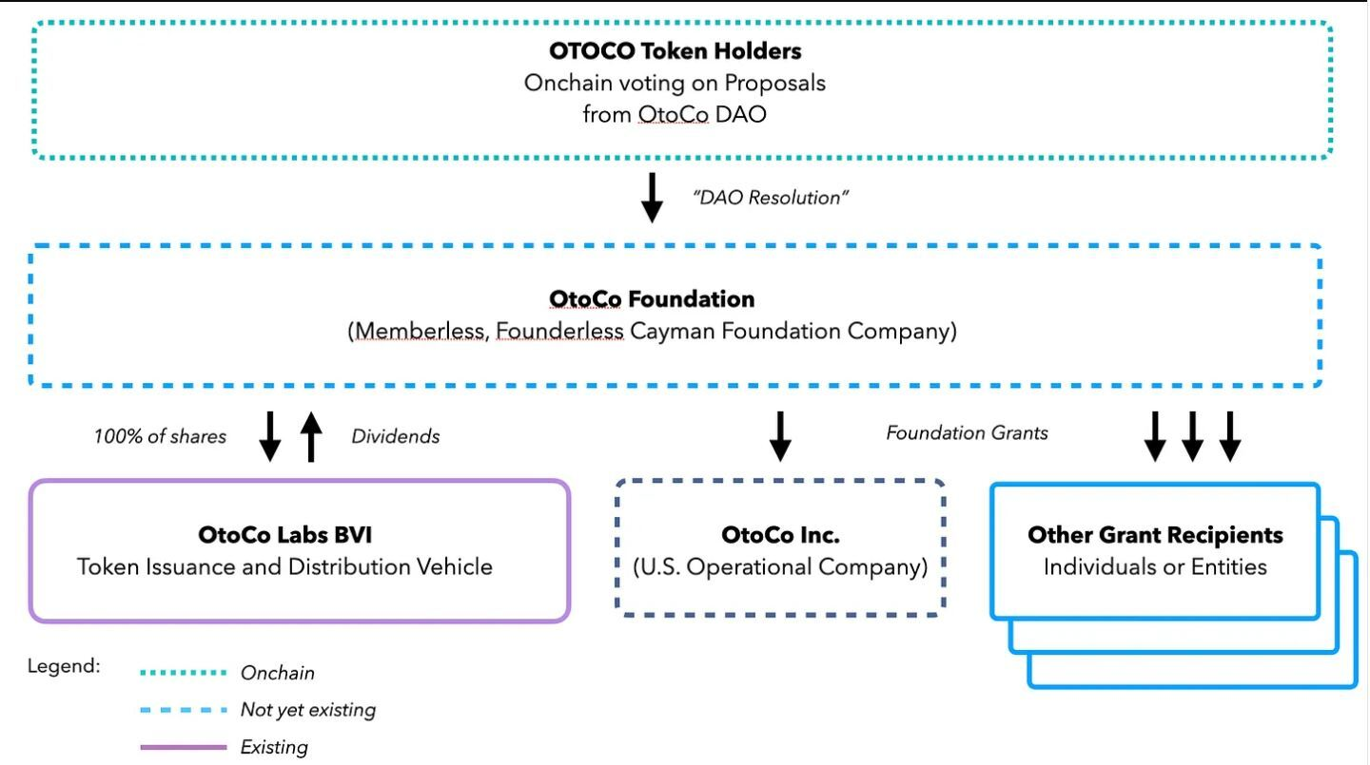
Cayman Foundation Companies as Legal Wrappers for DAOs
Source: https://newsletter.otonomos.com/p/the-otoco-foundation-a-decentralized

Slide 8
US State-Level Legislative Models
Wyoming’s Decentralized Autonomous Organization Supplement (2021)
  Automatic LLC status for qualifying DAOs
  Disclosure of “member-managed” vs. “algorithmically managed” status
  Default rules relieving token holders of fiduciary duties
  Provisions for dissolution if the smart contract address fails
  Source: https://sos.wyo.gov/Forms/WyoBiz/DAO_Supplement.pdf
Tennessee’s Decentralized Organization Act (2022)
  Allows existing LLCs to convert to decentralized organizations
  Flexible governance: algorithmic, member- or manager-managed, hybrids allowed
  Mandatory disclosures about asset lock features in the code
  Source: https://www.capitol.tn.gov/Bills/112/Amend/HA0748.pdf
Broader significance of wrappers
  Clarify debtor eligibility under the US bankruptcy law
  Reduce service-of-process complications
  Offer a scalable templated for adoption by other jurisdictions

Slide 9
Service and Jurisdiction in a Borderless Network
Establishing Jurisdiction
  Pure DAOs: Ooki DAO (jurisdiction founded in tokenholders residing in US, availability of protocol in US, and advertising Ooki Protocol on social media)
  DAO Adjacent Entity: Hector DAO (BVI links included Hector Enterprises Inc, a BVI incorporated adjacent entity and the appointment of BVI Receivers)
Service of Process
  Ooki DAO (service of process via the DAO’s online community forum deemed sufficient notice)
Identifying Responsible Parties
  Who is accountable for wrongdoing? Who is in control for enforcement purposes?
  Directors’ Duties: are powers fettered by token holders decision-making control?
Ownership of Assets
  DAO Treasury assets: held on trust for token holders or are they assets of the foundation company?

Slide 10
Cross-Border Insolvency: Chapter 15 and Beyond
First DAO Recognition
  In re Hector DAO (Bankr. D.N.J. July 15 2024) – BVI receivership recognized as a “foreign main proceeding”
    First time a DAO was treated as a “debtor” in US bankruptcy practice
    First Ch 15 case where all of the debtor’s management functions existed only in smart contract code and token holder votes
    First cross-border insolvency in which the foreign “company” had no charter, directors, or physical HQ – only a blockchain address
Missing analysis & thorny mechanics for KYC, proofs of claim, and distributions
  Some of the open issues include:
    How did a borderless protocol qualified as a legal person?
    Why did BVI constitute COMI?
    How were the creditors’ due process rights satisfied?
  Bankruptcy “plumbing” assumes claimants have verifiable identifies. DAOs assume the opposite. Future cases will need to sketch the doctrinal details to solve the nuts-and-bolts problems of identifying, counting, and paying on-chain creditors in a way that satisfies both bankruptcy law and modern privacy expectations.

Slide 11
Practical Implications for Advisers
Pre-distress planning
  Track legal wrappers & COMI signals
  Save periodic snapshots of token holder lists, voting outcomes, treasury wallet balances
  Review smart contract upgrades and treasury policy
Once distress arises
  Challenge critical issues early (i.e., standing, venue, recognition, COMI findings)
  Audit token-based voting mechanics and classification of claims (especially, if insiders hold governance tokens with special rights)
  Consider whether to press for appointment of an independent examiner or on-chain forensic specialists to following missing funds and NFT outflows
  Demand transparency on KYC/AML protocols
  Ensure potential claims against insiders, auditors, or exploiters are not released prematurely

